Slide 1
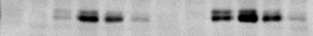
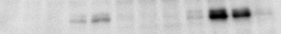
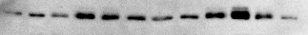
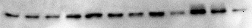
IRF3
IRF3
0.5 μg/ml
Poly I:C
50 μg/ml
Poly I:C
1 ng/ml LPS
100 ng/ml LPS
0 10 30 60 2h 4h
0 10 30 60 2h 4h
0 10 30 60 2h 4h
0 10 30 60 2h 4h
pIRF3
IRF3
WB: NE
WB: NE
10 30 60 120 240
10 30 60 120 240

Slide 2
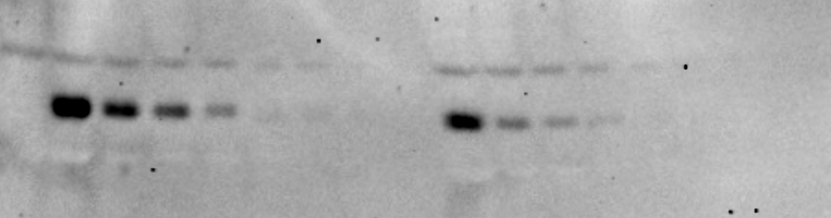
100 ng LPS (1 hr.)
50 ug Poly I:C (1 hr.)
0
2-Fold Dilutions
2-Fold Dilutions
pIRF3
Ser396
1:8
1:8

Slide 3
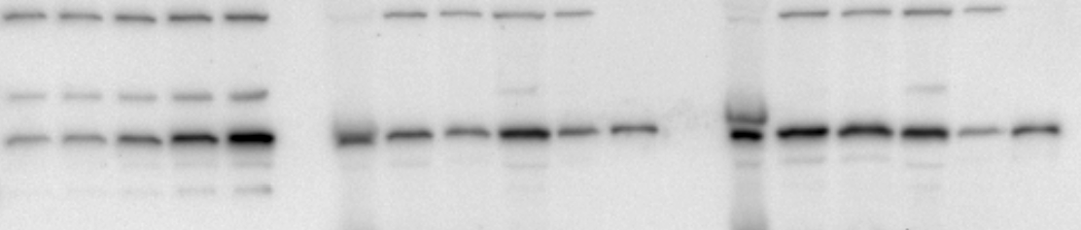
WCE1
CE1
NE1
WCE2
CE2
NE2
Dilution Factor
1:2
1:4
1:4
1:4
1:2
1:4
1:4
1:4
Recombinant IRF3 (ng)
2.5
5
1.43
0.97
2.96
1.03
1.08
3.43
2.67
2.38
0.52
1.25
.313
.625
1.25
26.2 ± 10 nM IRF3 in a single cell
Interestingly, the ratio of cytoplasmic to nuclear IRF3 is nearly 1:1
Assume a single BMDM has a total volume of 5 pL and the nucleus is 20% of the total volume.

Slide 4
7/9/11
WT
TRIF -/-
MyD88 -/-
0 5 15 30 45 60 90 120
0 5 15 30 45 60 90 120
0 5 15 30 45 60 90 120
1 ng LPS
GST-IkBa (1-54)
NEMO
WT
TRIF -/-
MyD88 -/-
0 5 15 30 45 60 90 120
0 5 15 30 45 60 90 120
0 5 15 30 45 60 90 120
100 ng LPS
GST-IkBa (1-54)
NEMO

Slide 5
EMSA – G1/G2, BMDM 10/21/10
1 ng/ml LPS
100 ng/ml LPS
0 10 30 60 2h 4h 10 30 60 2h 4h

Slide 6
IKK Kinase Assay 9/28/11
TRIF -/-
MyD88 -/-
TRIF -/-
+ 0.1 ng LPS
+ 1 ng LPS
MyD88 -/-
+ 10 ng LPS
+ 100 ng LPS
MyD88 -/-
TRIF -/-
MyD88 -/-
TRIF -/-
MyD88 -/-
TRIF -/-
MyD88 -/-
TRIF -/-
0 0 15 30 45 15 30 45 15 30 45 15 30 45
0 0 7.5 10 15 30 7.5 10 15 30 7.5 10 15 30 7.5 10 15 30
GST-FL-IκBα
IKK2

Slide 7
0.1 ng LPS
1 ng LPS
10 ng LPS
100 ng LPS
MyD88 -/-
TRIF -/-
MyD88 -/-
TRIF -/-
MyD88 -/-
TRIF -/-
MyD88 -/-
TRIF -/-
M
T
M
T
0 0 .16 .5 1 2 .16 .5 1 2 .16 .5 1 2 .16 .5 1 2
0 0 .16 .5 1 2 .16 .5 1 2 .16 .5 1 2 .16 .5 1 2
EMSA: BMDM, G1/G2 probe 9/27/11 – same mice as previous KA data
Did not quantify 100 ng LPS because the gel did not dry properly and those lanes are blurry.

